Slide 1
IT-331 ( Computer Graphics 1)
Lecture 10
Polygon Fill-Area Clipping
Dr. Mohammed El-Said
Assistant Professor, Computer Science Dept.,
Faculty of Computers & Artificial Intelligence,
Helwan University - Cairo, Egypt.

Slide 2
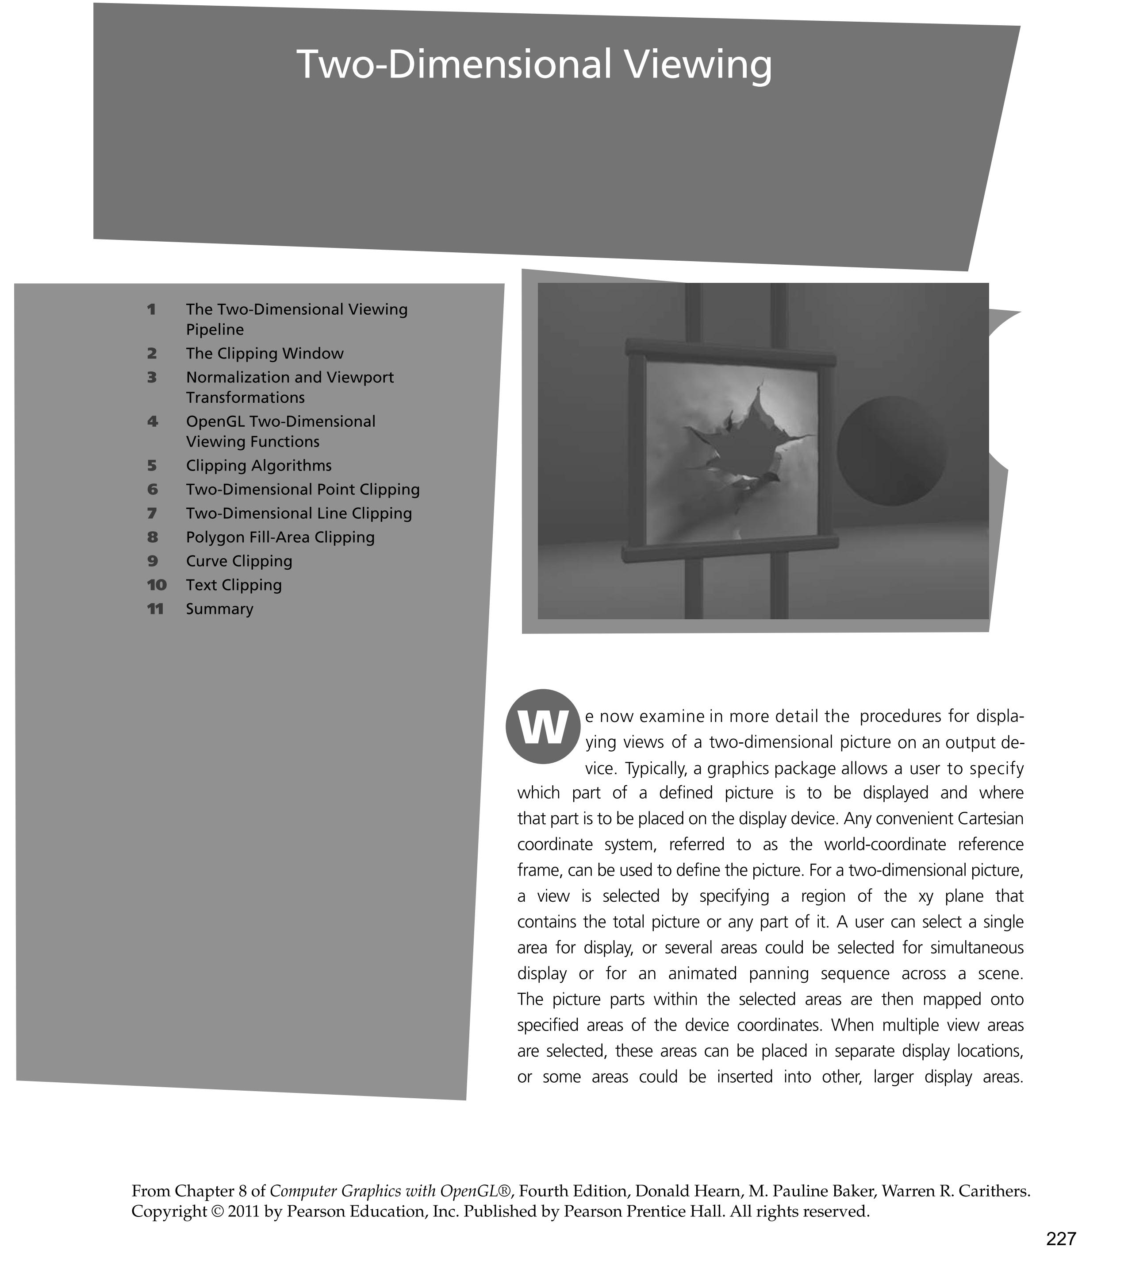

Slide 3
Two-Dimensional Clipping
Point clipping – trivial
Line clipping
  Cohen-Sutherland
  Liang-Barsky
  Nicholl-Lee-Nicholl
Polygon Fill-Area clipping
  Sutherland-Hodgeman
  Weiler-Atherton

Slide 4
Polygon clipping
Clipping a polygon fill area needs more than line-clipping of the polygon edges
  would produce unconnected set of lines
Must generate one or more closed polylines, which can be filled with the assigned colour or pattern

Slide 5
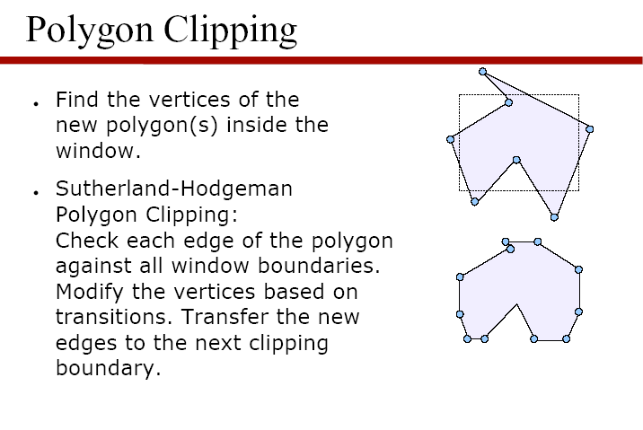

Slide 6
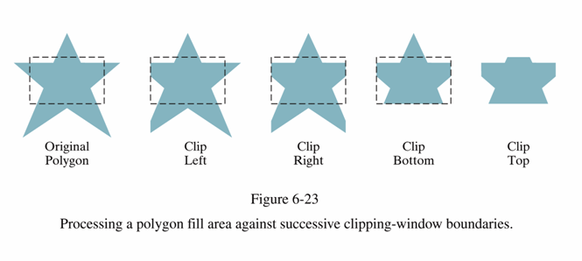

Slide 7
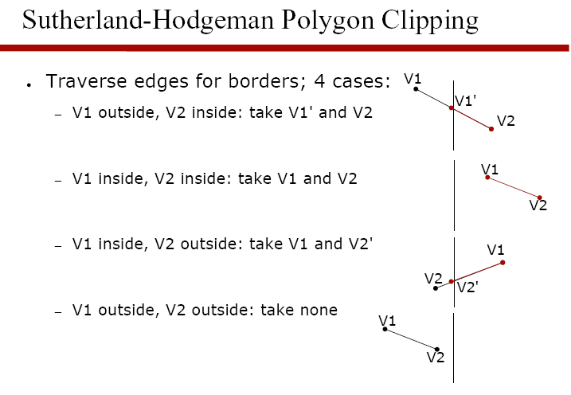

Slide 8
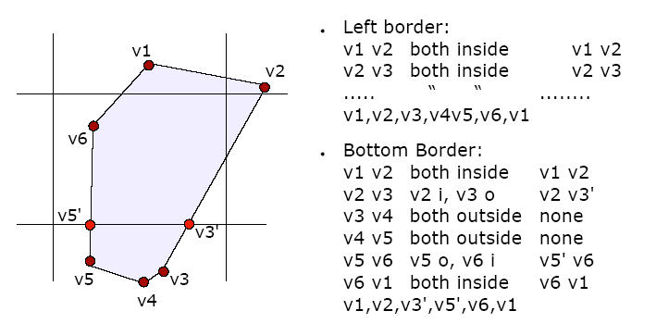

Slide 9
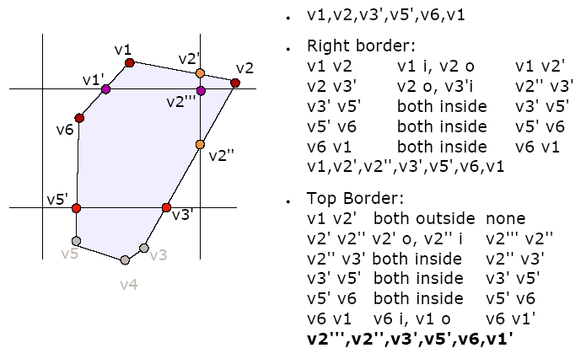

Slide 10
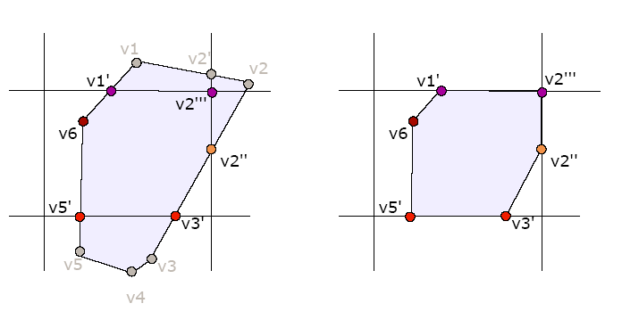

Slide 11
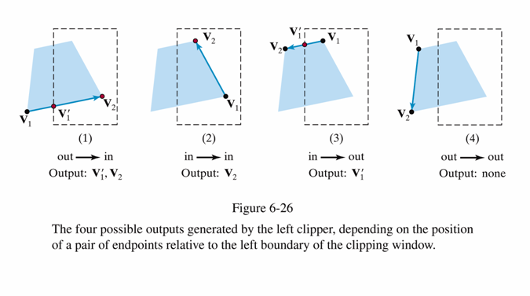

Slide 12
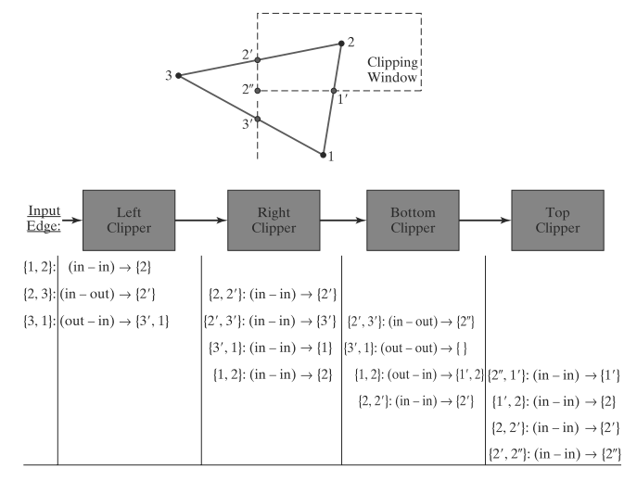

Slide 13
Sutherland-Hodgman Polygon Clipping
The algorithm correctly clips convex polygons, but may display extraneous lines for concave polygons

Slide 14
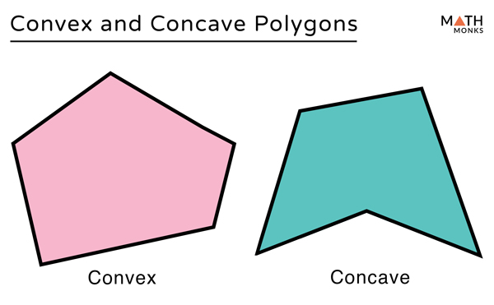

Slide 15
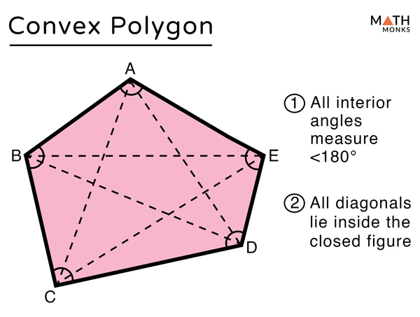

Slide 16
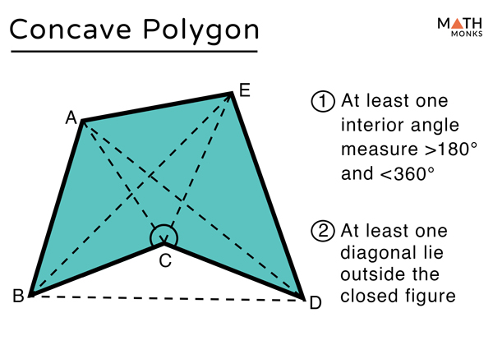

Slide 17
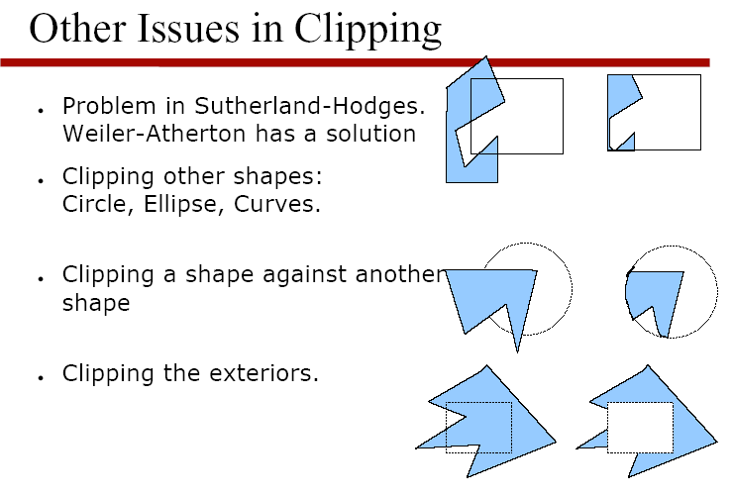

Slide 18
Weiler-Atherton Polygon Clipping
Another approach to polygon clipping
No extra clipping outside window
Works for arbitrary shapes
Avoids degenerate polygons

Slide 19
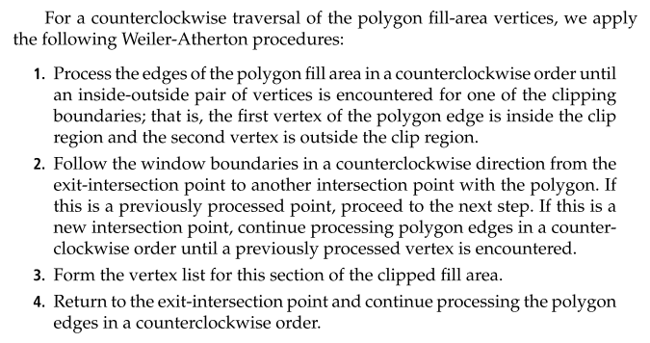
Weiler-Atherton Polygon Clipping

Slide 20
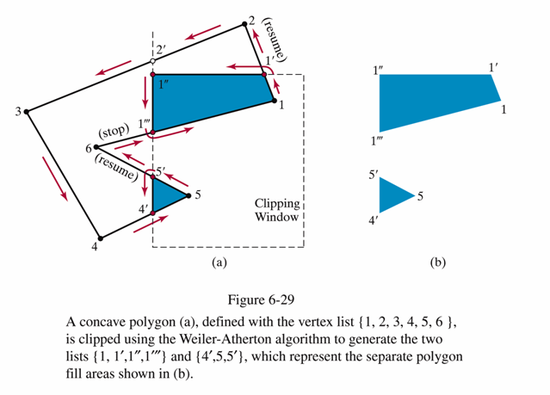
Weiler-Atherton Polygon Clipping counter-clockwise orientation of subject polygon
For an outside-to-inside pair of vertices, follow the polygon boundary
For an inside-to-outside pair of vertices, follow the window boundary in a counter-clockwise direction

Slide 21
Generalizations of W-A
Can be extended to complex situations, arbitrary windows
Stability issues can arise for such cases

Slide 22
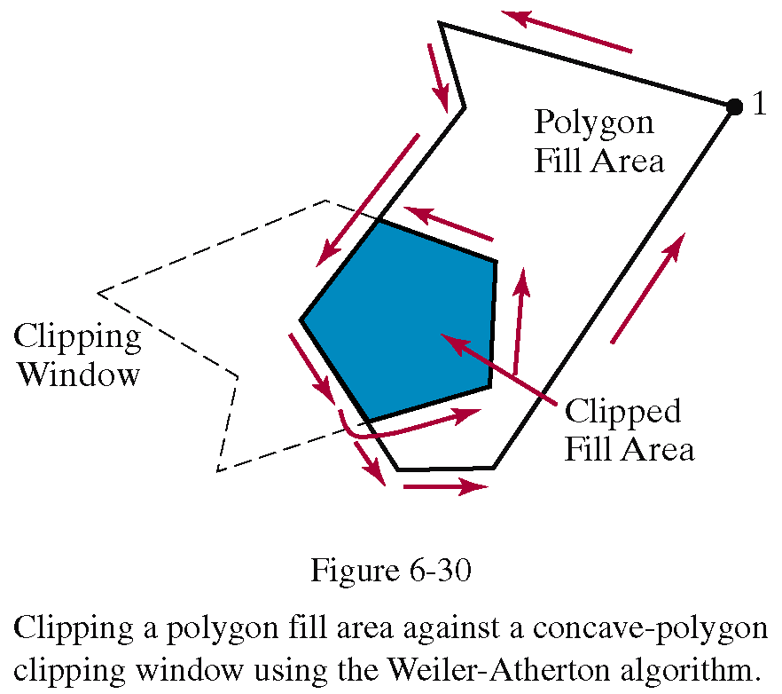
Weiler-Atherton Polygon Clipping
Polygon clipping using nonrectangular polygon clip windows

